Slide 1
Lecture 11 – Access Control

Slide 2
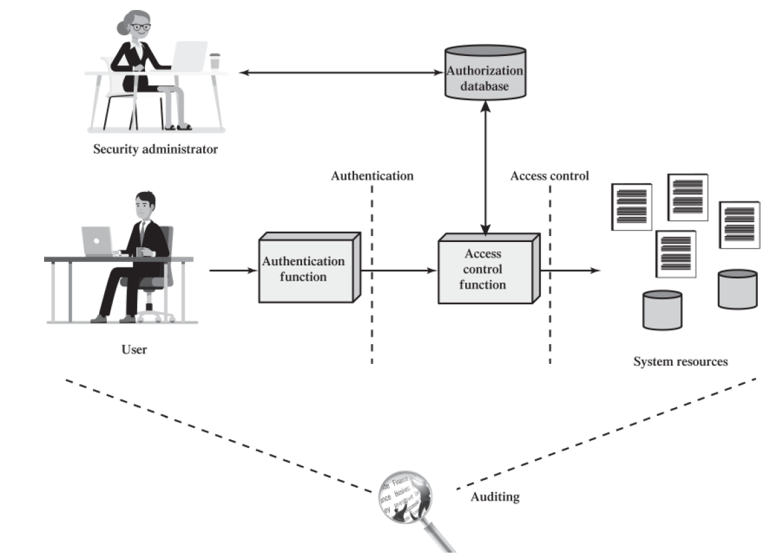
Relationship Between Access Control and Other Security Functions

Slide 3
Access Control Policies
Discretionary Access Control - Controls access based on the identity of the requestor and on access rules (authorizations) stating what requestors are (or are not) allowed to do. This policy is termed discretionary because an entity might have access rights that permit the entity, by its own volition, to enable another entity to access some resource.
Mandatory Access Control - Controls access based on comparing security labels(which indicate how sensitive or critical system resources are) with security clearances (which indicate system entities are eligible to access certain resources). This policy is termed mandatory because an entity that has clearance to access a resource may not, just by its own volition, enable another entity to access that resource.
Role-based access control - Controls access based on the roles that users have within the system and on rules stating what accesses are allowed to users in given roles.
Attribute-based access control - Controls access based on attributes of the user, the resource to be accessed, and current environmental conditions.
Not necessarily mutually exclusive.

Slide 4
Subjects
Three classes (recall the last practicum)
Owner
Group
World
Access Rights
Read
Write
Execute
Delete (probably write on Linux?)
Create (probably write on Linux?)
Search (probably read on Linux?)

Slide 5
Access Control Data Structures
Much like graph adjacency
Matrix
List
Access Lists
Capability Lists

Slide 6
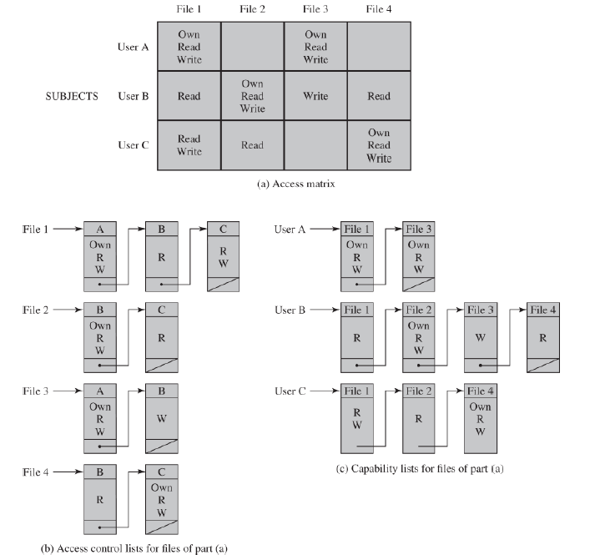

Slide 7
Pros and Cons
Matrix
Cons: Sparse, wastes space
Pros: Direct Access
Access Lists
Cons (if you use a hashmap): ?? -> probably why these are so common
Pros: Users interact with files frequently
Capability Lists:
Cons: Users may interact with every file
Mitigated with default permissions (probably read-only or no access).
Pros: Great for Discretionary Access Control

Slide 8
Capability tickets
A way to implement DAC
An existing authorized user creates and signs the ticket for the newly authorized user.
This creates a lot of attack services, best to wrap this functionality in the OS as much as possible.

Slide 9
DAC Access Control Model
Developed by Lampson, Graham, and Denning c. 1971-1972
Extends the Subjects to include:
Processes
Access rights include: delete, stop (block), and wakeup
Devices
Access rights include: read, write, block, unblock
Memory Locations (this may have been before protected mode was a thing?)
Access rights similar to files
Subjects
Here’s where the DAC hierarchy comes in, you can own or control other subjects recursively.

Slide 10
Protection Domains
Additional layers of access control to temporarily (for the lifetime of a process) adjust privileges
For example: user mode vs. kernel mode.

Slide 11
Role-Based Access Control
NIST FIPS 140-3 c. 2009 recommends this approach.
Roles get mostly-fixed privileges on a system
A user can have multiple roles
Can probably be simulated using groups on linux

Slide 12

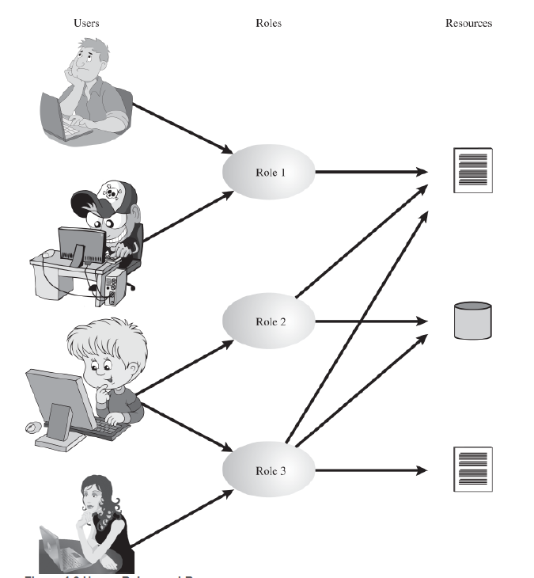
Roles

Slide 13
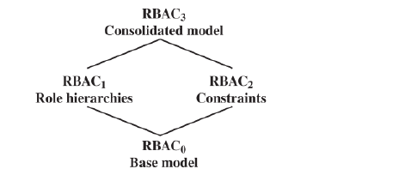
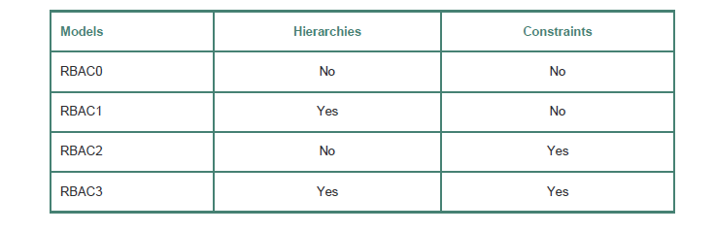
RBAC Reference Models

Slide 14
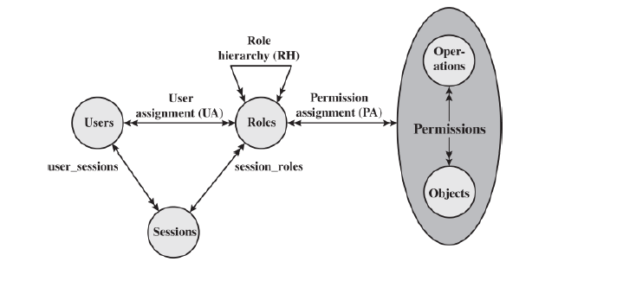
RBAC₀

Slide 15
Relationship Types
1:1
1:n
N:M

Slide 16
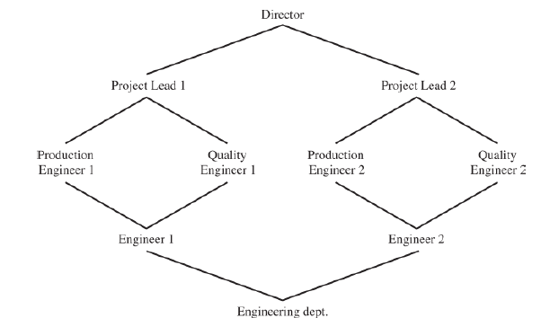
RBAC₁

Slide 17
RBAC₂
Constraints
Give additional flexibility to bespoke needs for administration of security at a particular institution.
Mutually Exclusive Roles
Under RBAC₀ users can have multiple roles, but maybe you don’t want to allow someone to be both a dev and quality control, for instance.
Cardinality
Maybe only a certain number of people can have a certain role.
Prereqs
Can only have role X if you already have role Y
Some overlap with hierarchies

Slide 18
RBAC₃
Has features of both RBAC1 and RBAC2 (and by transitivity RBAC0).

Slide 19
Attribute-Based Control
Subjects
Users, Processes, etc., just like before.
Username, Group like on Linux
No reason why you can’t include org, start date, pay grade, etc.
Objects
Files, Devices, Etc., just like before
read, write, execute for starters
But no reason why your access policy can’t include filename, dates created, etc.
Environment
Date – maybe some files get locked a week before product launch
Network status – maybe some files are locked over wifi, but not wired
Etc.

Slide 20
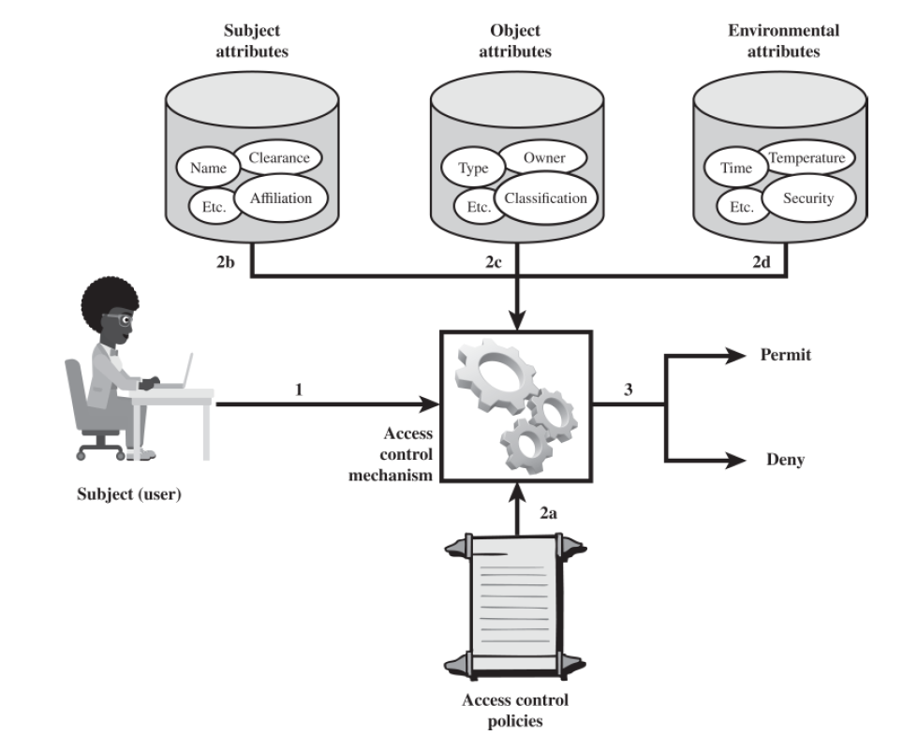

Slide 21
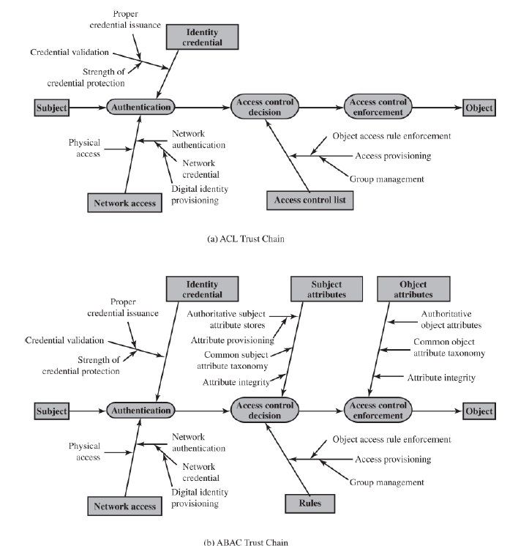
Comparing DAC ACLs with ABAC
The same Authentication mechanism
But Access Control decisions and Access control enforcement become more complicated because of:
Subject Attributes
Object Attributes

Slide 22
Identity, Credential, and Access Management
ICAM for short
Mechanism for the creation of digital identity representations for of individuals and non-person entities (NPEs) (processes and automated devices).

Slide 23
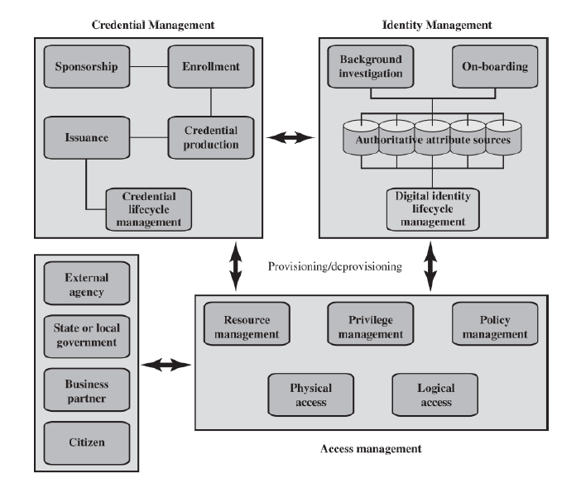

Slide 24
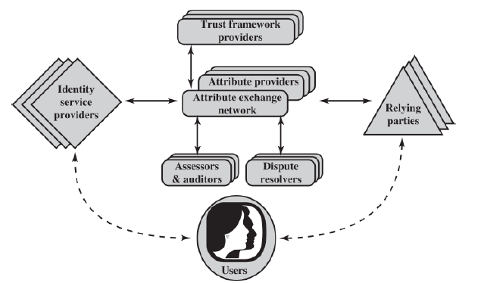
Trust Frameworks

Slide 25
Open Identity Trust Framework
OpenID – A standard for websites to authenticate users by relying on trusted third parties
OIDF – The OpenID Foundation, the non-profit associated with promoting, protecting, and enabling OpenID Technologies
ICF – the Information Card Foundation, another non-profit pushing an authentication technology
OITF – Open Identity Trust Framework – An Open Specification of a Trust Framework and Attribute Exchange developed jointly by OIDF and ICF
OIX – The Open Identity Exchange Corporation, an international provider of certification trust networks based on OITF
AXN – Attribute Exchange Network is an Internet-Scale Gateway for Identity Service Providers

Slide 26
First and Second Parties
Relying parties (RPs): Also called service providers, these are entities delivering services to specific users. RPs must have confidence in the identities and/or attributes of their intended users, and must rely upon the various credentials presented to evince those attributes and identities.
Subjects: These are users of an RP’s services, including customers, employees, trading partners, and subscribers.
Attribute providers (APs): APs are entities acknowledged by the community of interest as being able to verify given attributes as presented by subjects and which are equipped through the AXN to create conformant attribute credentials according to the rules and agreements of the AXN. Some APs will be sources of authority for certain information; more commonly APs will be brokers of derived attributes.
Identity providers (IDPs): These are entities able to authenticate user credentials and to vouch for the names (or pseudonyms or handles) of subjects, and which are equipped through the AXN or some other compatible Identity and Access Management (IDAM) system to create digital identities that may be used to index user attributes.

Slide 27
Third Parties
Assessors: Assessors evaluate identity service providers and RPs and certify that they are capable of following the OITF provider’s blueprint.
Auditors: These entities may be called on to check that parties’ practices have been in line with what was agreed for the OITF.
Dispute resolvers: These entities provide arbitration and dispute resolution under OIX guidelines.
Trust framework providers: A trust framework provider is an organization that translates the requirements of policymakers into an own blueprint for a trust framework that it then proceeds to build, doing so in a way that is consistent with the minimum requirements set out in the OITF specification. In almost all cases, there will be a reasonably obvious candidate organization to take on this role, for each industry sector or large organization that decides it is appropriate to interoperate with an AXN.

